Slide 1

WHEN I AM LEADER
IST 625 : Enterprise Risk Management
PRATYUSH KULWAL

Slide 2

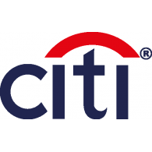
BACKGROUND
Established in 1919 at Shanghai
Business Areas: AIG Life and Retirement, AIG Property Casualty, United Guarantee Cooperation
Industry: Insurance and Financial Services
Influencers: 1967- 2005: Hank Greenberg
Low Frequency High Impact Event: During 2008 financial disruption US government took 79.9% equity stake
Established in 1998 by merger of Citicorp and Travelers
Business Areas : Global Consumer, Global Wealth Management and Citi Institutional Client Group
Industry: Banking and Financial Services
Influencers: 2007- 2012: Vikram Pandit
Low Frequency High Impact Event: During 2008 financial disruption US government took 36% equity stake
Notes:
BACKGROUND:
Establishment:
In 1919, American Asiatic Underwriters Federal, Inc. was founded at Shanghai by Cornelius Vander Star. The company moved its headquarters to New York in 1939 to operate its businesses from United States and in 1967 the company was renamed to American International Group – also popularly known as AIG
Citigroup Inc. is an American multinational investment banking and financial services corporation which was formed on October 9, 1998, following the $140 billion merger of Citicorp and Travelers groups to create the world's largest financial services organization
Business Areas :
For AIG Business Areas: Insurance, Global Financial Services, Real Estate, Sun America Mutual Funds
For Citi group Business Areas : Global Consumer, Global Wealth Management and Citi Institutional Client Group
3. Industry:
AIG is one of the biggest players in insurance market while, Citibank provides Banking and financial Services
4. Influencers:
Hank Greenberg was CEO of the institution since 1967, under his supervision AIG had expanded its business to Mortgage lines and was listed on New York Stock Exchange
In 2005, Hank was removed from postion of CEO after an accounting fraud which costed AIG $`1.6 Billion.
Vikram Pandit, CEO of citi from 2007-2012, brought back Citi to its current status after global meltdown
5. Impact
Loss of capital and trust of investors, organizations on the verge of bankruptcy

Slide 3
HIGH IMPACT EVENT: FINANCIAL CRISIS of 2008
Financial and Equity losses : They had to take a bailout of $80 billion for 79.9% stake
Stock Prices: Dropped about 90%
Layoffs: 15,000
Loss of Investor Trust
Financial and Equity losses : They had to take a bailout of $25 billion for 36% stake
Stock Prices: Dropped about 98%
Layoffs : 75,000
Loss of Investor Trust
Notes:
Stock Prices: For Citibank, Its stock market value dropped to $20.5 billion, down from $244 billion two years earlier. Shares of Citigroup common stock traded well below $1.00 on the New York Stock Exchange
Layoffs: Citigroup eliminated 5% of their global workforce which was around 17,000 jobs (Spencer, 2007). In 2008, Citigroup retrenched 52,000 employees which was another 14% of their workforce (Dash, 2008).
How did they overcome the impact ?
They got bailout packages from the US government for exchange on an equity

Slide 4
DEFINING AND MEASUREMENT of RISK
CREDIT RISK
MARKET RISK
OPERATIONAL RISK
RISK MEASURMENT
VAR, SVA, Stress Testing
Key Rate duration, Scenario analysis, Value at Risk, Stress Testing
Establishment of guidelines for Risk Assessment
Notes:
AIG’s market exposures can be categorized as follows:
• Benchmark interest rates.
• Credit spread or risk premium. Credit spread risk is the potential for loss due to a change in an instrument’s risk premium or yield relative to that of a comparable-duration, default-free instrument.
• Equity and alternative investment prices.
• Foreign currency exchange rates. AIG is a globally diversified enterprise with significant income, assets, liabilities and capital denominated in a variety of currencies.
AIG uses a number of measures and approaches to measure and quantify its market risk exposure, including:
• Duration/key rate duration. Duration is the measure of the sensitivities of a fixed-income instrument to the parallel shift in the benchmark yield curve. Key rate duration measures sensitivities to the movement at a given term point on the yield curve.
• Scenario analysis. Scenario analysis uses historical, hypothetical, or forward-looking macro-economic scenarios to assess and report exposures.
• Value-at-Risk (VAR).
• Stress testing.

Slide 5
DEFINING AND MEASUREMENT of RISK
RISK MEASURMENT
VAR based on
• Prob. of Default – ORR • LGD – FRR
VAR based on :
• Factor Sensitivity • Potential Losses
Back Testing
VAR based on
• Loss frequency
• Loss severity
Metrics / KRIs, Scenario Analysis
Credit risk
Market risk
Liquidity risk
Price risk
Operational risk
Legal risk
Reputational exposures
Notes:
Current Risk Measurement Practices:
Credit Risk :
Probability of default (PD) is a financial term describing the likelihood of a default over a particular time horizon. It provides an estimate of the likelihood that a borrower will be unable to meet its debt obligations.
ORR stands for Obligatory Risk Rating
The LGD calculation is easily understood with the help of an example: If the client defaults with an outstanding debt of $200,000 and the bank or insurance is able to sell the security (e.g. a condo) for a net price of $160,000 (including costs related to the repurchase), then the LGD is 20% (= $40,000 / $200,000).
FRR stands for Facility Risk Rating
MARKET RISK
Factor Sensitivity : Sensitivity is the magnitude of a financial instrument's reaction to changes in underlying factors. Financial instruments, such as stocks and bonds, are constantly impacted by many factors. Sensitivity accounts for all factors that impact a given instrument in a negative or positive way in an attempt to learn how much a certain factor will impact the value of a particular instrument.
VAR Based on Potential Losses.
Back Testing: Back testing is the process of applying a trading strategy or analytical method to historical data to see how accurately the strategy or method would have predicted actual results.
OPERATIONAL RISK:
Scenario Analysis: Analyzing a particular scenario.
They also use VAR based on Loss Sensitivity and Loss Frequency
KRI stands for Key Resource Indicators

Slide 6
RISK MANAGEMENT
CREDIT RISK | Setting up of limits in VAR | Setting up of limits in VAR
MARKET RISK | Setting up of limits in VAR | Model Review and Validation, Stress Testing, Soundness Standards
OPERATIONAL RISK | Managing and Modifying Operating guidelines | Reviewing Metrics regularly, Internal Audits
HI
Notes:
This slide shows Current Risk Management Practices
Risk Management Structure was established for Risk reporting and Management
For Citi Bank:
Business Chief Risk Officer: Focal point for risk decisions in company’s major business groups
Regional Chief Risk Officer: They reported to Business Chief Risk Officer and were accountable for risks in their geographic areas
Product Chief Risk Officers: They reported to Regional Chief Risk Officer and were Accountable for risks within their speciality (real estate, structured products, etc)
For AIG :
Each Division of businesses have Risk Officers which reports Risks to Chief Risk Officer.
Both Citi and AIG have categorized their risks into credit, market and operational risks.

Slide 7
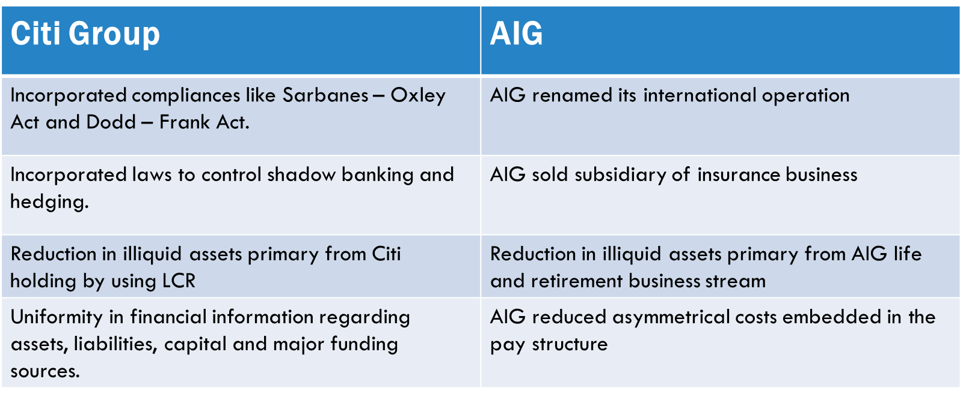
Contingency and disaster planning (After 2008 MELTDOWN)
Notes:
Citigroup took major step by incorporating laws to restrict and control shadow banking.
Citigroup enforced laws to comply with Sarbanes-Oxley Act which meant changes in ownership and disclosure requirement.
Citigroup reduced in illiquid assets primary from Citi holding, which resulted in increased core deposits and higher equity levels.
Then CEO of Citigroup brought about uniformity in financial information regarding assets, liabilities, capital and major funding sources.
AIG renamed its international operation from AIU holding to Chartis operation in bid to gain trust of investors.
In pursuit of rebranding, AIG sold subsidiary of insurance business to MetLife.
AIG reduced illiquid assets primary from AIG life and retirement business stream
AIG reduced asymmetrical embedded in the pay structure.

Slide 8
Similarities/DIFFERENCES in approach
Preferred giving bonuses.
Well informed of latest technology.
Enforced strict regulations like Sarbanes-Oxley Act and Dodd– Frank Act.
Reduction in illiquid assets, Citigroup concentrated more on Liquidity Coverage Ratio
AIG concentrated more on rebranding themselves and selling business units
Notes:
As the path to recovery, both companies preferred giving bonuses in millions to the higher executives which were highly condemned by the investors and were subjected to public outrage.
Both companies had to continue their business operations and stay abreast with latest technologies which required a huge capital investment.
Both companies had to enforce strict regulations like Sarbanes-Oxley Act and Dodd– Frank Act which brought about lot of changes in disclosure and ownership financial requirements.
Both companies aimed at reducing illiquid assets
AIG had majority of business in insurance sector and people were backing out to renew their policies , therefore AIG concentrated on rebranding themselves and selling non performing assets.

Slide 9
RISK MANAGEMENT PRACTICES
Use predictive modelling and statistical methods using historical data to make strategic decisions
Introduce Scenario and what-if analysis for each and every possible scenario
Quantifying all the risks in terms of Dollar value
Introducing auditing practices and procedures to manage and mitigate risks
Deploying and Implementing enhanced technologies which streamline operations
Notes:
In my opinion Citigroup and AIG should have revamped their ERM organization structure to focus on developing comprehensive and integrated approach to risk.
Firstly, With the advent of computational power and use of statistics. Organizations must leverage on Big data technologies and use statistical and predictive modelling to make strategic decisions for Risk Management.
Secondly both the companies should have in place separate scenario analysis department which uses measurement strategies like Value At Risk, Monte Carlo Modelling and Stress Testing. This analysis will help to analyze how the companies were affected in past, what was the effect on stocks and what was the reaction of business community.
Thirdly all the risks should be quantitative and statistically measureable for business to form risk map and risk registers on the basis of impact and probability of occurrence of risk. Moreover both companies should incorporate strict guidelines as laid out by Basel committee.
Fourthly Risk management strategies already in place should have been embraced, the top management to pay attention towards the downside of the risk exposure. Companies should ensure strict abidance to the regulation compliances such that there is no discrepancies in financial and auditing reports. Both companies should also aim at setting up a framework/models approved by federal reserve board and office of the controller of the currency (OCC) to calculate Regulatory VAR, Regulatory SVAR, Incremental Risk Charge (IRC) and Comprehensive Risk Measure (CRM)
Lastly, both the companies should have aimed project and activities aimed at enhancing its operational capabilities and resolvability in CFCP ( contingency Funding and Capital Plan) , Management Information System (MIS) and Capital Maintenance Agreement (CMA).
They must deploy and implement latest technologies which may place them with competitive advantage.

Slide 10
REFRENCES
Citi. (21 September, 2011). Retrieved 18 March, 2016, from Citi Statement on Moody's Announcement: http://www.citigroup.com/citi/press/2011/110921a.htm
Citi. (21 June, 2012). Retrieved 18 March , 2016, from Citi Statement on Moody's:http://www.citigroup.com/citi/news/2012/120621a.htm
Citi. (June, 2013). Retrieved 18 March , 2016, from Citi Statement on http://www.citigroup.com/citi/investor/data/b25d130630.pdf?ieNocache=32
Witkowski, W. (6 February, 2009). Fitch downgrades Citi individual, preferred ratings. Retrieved from http://articles.marketwatch.com/2009-02-06/news/30917075_1_idr-individual-rating-long-term-issuer default-rating Hopkins, C. (6 April, 2013). Senators Draft Higher Capital Requirement for Biggest U.S. Banks. Bloomberg.
Crouhy, M. G., Jarrow, R., & Turnbull, S. (2007). The Subprime Credit Crisis of 07. The Journal of Derivatives, Fall 2007.
Cho, D., & Appelbaum, B. (13 January, 2010). Obama's 'Volcker Rule' shifts power away from Geithner. Washington Post.
AIG Case Study. (n.d.). Retrieved 18 March , 2016, from https://prezi.com/wrfior4zetwi/aig-case-study/
American International Group (AIG). (n.d.). Retrieved 18 March , 2016, from http://www.wikinvest.com/stock/American_International_Group_(AIG)/Risk_Management
AIG, Credit Default Swaps, and "Risk Management" (2008). Retrieved 18 March , 2016, from http://baselinescenario.com/2008/11/07/financial-crisis-risk-management/
https://www.fas.org/sgp/crs/misc/R42953.pdf

